Slide 1

PRESENTATION ON PROJECT
ATTENDANCE MANAGEMENT SYSTEM BY FACIAL RECOGNIZATION
BY : SAKSHI RAWAT
EN.NO: 0101CA201027

Slide 2
CONTENT
Introduction
Purpose
Feasibility study.
Technology Used.
Methodology.
Disadvantages of manual attendance system.
Tools and technology.
Pros
Cons
Features
ER-DIAGRAM
Flowchart.
Motivation and challenges.
Future Scope
Conclusion
References.

Slide 3
Introduction
Attendance Management system is a software developed for daily Attendance in School, Colleges And Institutions.
It Facilitates us to access the attendance information of a particular Student in a particular class.
The information is Sorted by the operators which will be provided by the teacher for a particular class.
This System will also helps in evaluating attendance eligibility criteria of a student.

Slide 4
Purpose
The purpose of developing attendance management system is to computerized the tradition way of taking attendance.
Another purpose for developing this software is to generate the report automatically at the end of the session or in the between of the session.

Slide 5
Feasibility study
Economically feasible
The system being developed is economic with respect to school for Colleges point of view.
It is cost effective in the sense that has eliminated the paper work completely.
The system is also time effective because the calculations are automated which are made at the end of the month or as per the user requirement.
The results obtained contains minimum errors and are highly Accurate as the data is required.

Slide 6
Feasibility study
Technical Feasibility:
The technical requirement for the system is economic and it does not use any other additional Hardware and software .
Behavioral Feasibility:
The system working is quite easy to use and learn due to its simple but attractive interface .
User requires no special training for operating the system.

Slide 7
Technology Used
The technology aims in imparting a tremendous knowledge oriented technical innovations these days. Deep Learning is one among the interesting domain that enables the machine to train itself by providing some datasets as input and provides an appropriate output during testing by applying different learning algorithms. Nowadays Attendance is considered as an important factor for both the student as well as the teacher of an educational organization. With the advancement of the deep learning technology the machine automatically detects the attendance performance of the students and maintains a record of those collected data.

Slide 8
Methodology
Before the attendance management system can work, there are a set of data needed to be inputted into the system which essentially consist of the individuals basic information which is their ID and their faces. The first procedure of portrait acquisition can be done by using the Camera to capture the faces of the individual. In this process the system will first detect the presence of a face in the captured image, if there are no face detected, the system will prompt the user to capture their face again until it meets certain number of portraits which will be 10 required portraits in this project for each student. The decision of storing only 10 portrait per student is due to the consideration of the limited storage space in the raspberry pi because the total amount of students in the university is considered heavy. Then, the images will undergo several pre-processing procedures to obtain a grayscale image and cropped faces of equal sized images because those are the prerequisites of using the EigenFaces Recognizer. Both of the processes mentioned above can be represented in the diagram below.

Slide 9
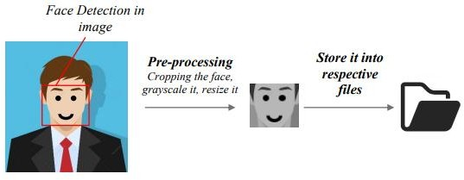
Stored Images

Slide 10
Disadvantages of present working system
Not user friendly: The existing system is not user friendly because the retrieval of data is very slow and data is not maintained efficiently.
Difficulty in report generating: we require more calculations to generate the report so it is generated at the end of the session and the student not get a single chance to improve their attendance.
Manual control: All the calculations to generate
Report is done manually so their greater chance of errors.

Slide 11
Disadvantages
Lots of paperwork
Existing system requires lots of paper work.
Loss of even a single register/record led to difficult situation because all the papers are needed to generate the reports.
Time consuming: every work is done Manually so we cannot generate report in the middle of the session or as per the requirement because its very time consuming.

Slide 12
Characteristics of the proposed system
User friendly:
The proposed system is user friendly because the retrieval and storing of data is fast and data is maintained efficiently .Moreover the graphical user interface provided in the proposed system. Which provides user to deal with the system very easily.
Reports are easily generated:
reports can be easily generated in the proposed system user can generate the report as per the requirement(monthly) or in the middle of the session user can give the notice to student so he she become regular.

Slide 13
Characteristics of the proposed system
Very less paper work:.
the purposed system required very less paper work. All the data is feted into the computer immediately and reports can be generated through computer
Moreover work becomes very easy because there is no need to keep data on papers .

Slide 14
Tools and Technology
Software Requirements
An operating system
HTML language
PYTHON language.
PHP language.
Hardware Requirements
Desktop/Laptop

Slide 15
PRO’s
For Students
Easily see their attendance
Easily accessible
For faculty
Easily to take attendance
Easily calculate of average attendance.
Reducing time for calculating worked hours.
Eliminating mistakes made during calculations.
Reducing time need to verify attendance data.
Reducing time for making reports and sending them to administrator .

Slide 16
CON’s
Problem related to software
Internet connections

Slide 17
FEATURES
Manage the attendance of all student and staff at once place.
Simple and easy interface for filling attendance of all staff and students.
Cumulative terms, mid-term and annual attendance can be generated.
The administrator can keep a note of staff attendance and keep a record of the same

Slide 18
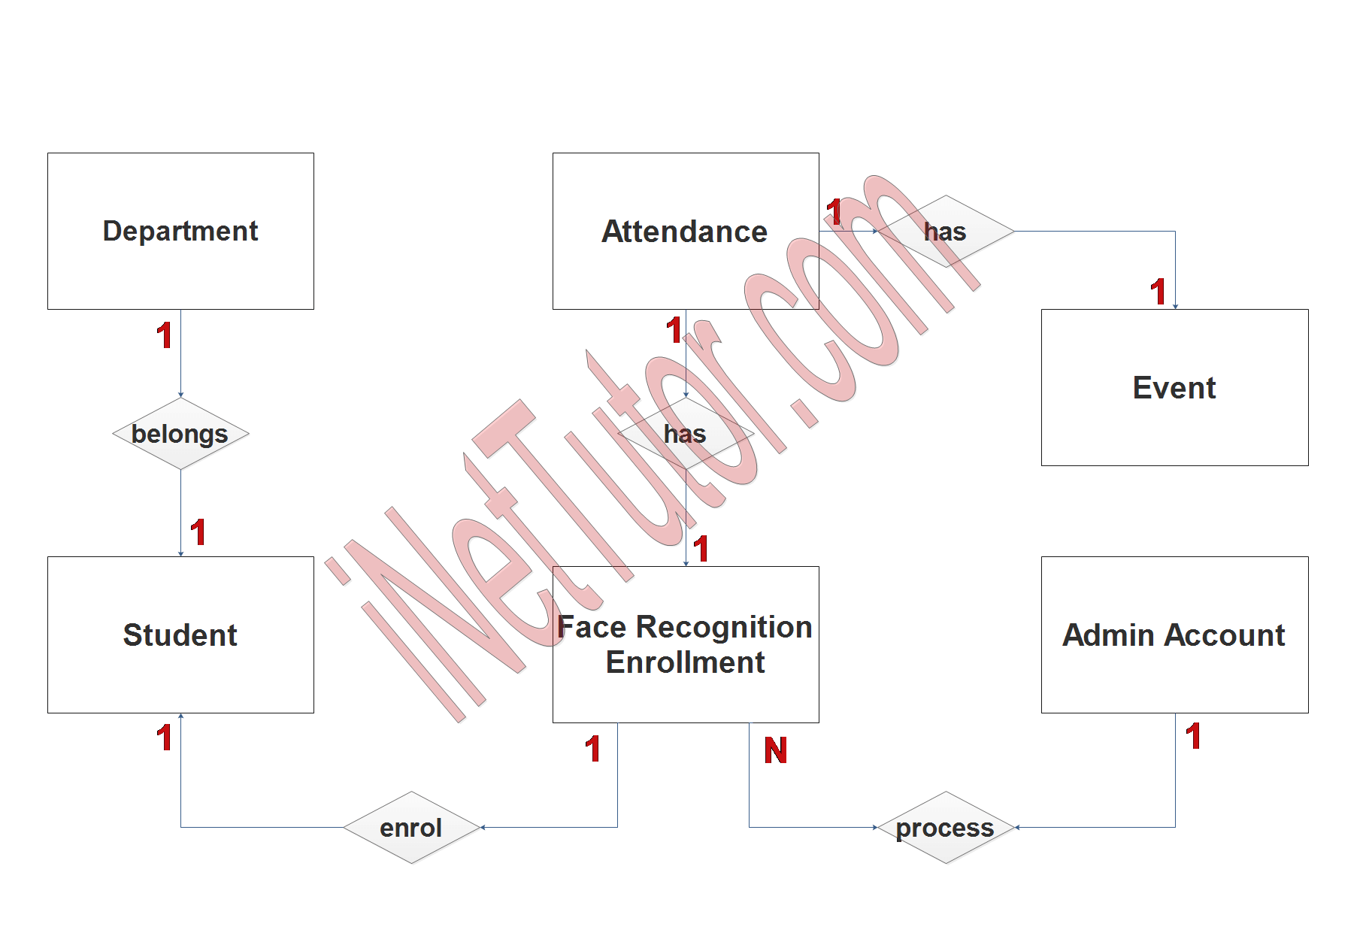
ER-digram
ER Diagram of project:

Slide 19
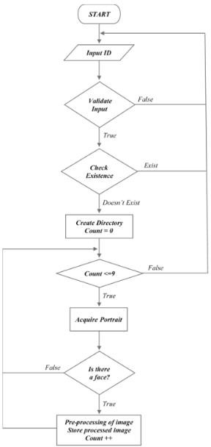
FLOW CHART

Slide 20
MOTIVATION AND CHALLENGES
In order to maintain in the record of the students for university of education wit accuracy , we will design a better attendance management system. And it is consider to be import key behind motivating this project .
In this way, this system will remove a problems of roll calling and will save this times of teachers as well as the students.
We can improve fingerprint identification system by decreasing the mating time.
For it we will divide the database to one tenth.

Slide 21
FUTURE SCOPE
Free approach to enter attendance
Free trouble to use.
Better user interface.
Highly reliable.

Slide 22
What face recognition Technology is?
: The facial recognition technology can be used in recording the attendance through a high-resolution digital camera that detects and recognizes the faces of the students and the machine compares the recognized face with students’ face images stored in the database. Once the face of the student is matched with the stored image, then the attendance is marked in attendance database for further calculation. If the captured images doesn't match with the students' face present in the database then this image is stored as a new image onto the database. In this system, there are possibilities for the camera to not to capture the image properly or it may miss some of the students from capturing.

Slide 23
SYSTEM DESIGN
The design part of the attendance monitoring system is divided into two sections which consist of the hardware and the software part. Before the software The design part can be developed, the hardware part is first completed to provide a platform for the software to work. Before the software part we need to install some libraries for effective working of the application. We install OpenCV and Numpy Python.

Slide 24
HARDWARE DEVELOPMENT
Camera Module with good mega pixels.
Power Supply Cable
16Gb Micro SD Card Class 10

Slide 25
LIBRARIES DEVELOPEMENT
openCV
The openCV project was initially an Intel Research initiative to advance CPU-intensive applications, part of a series of projects including real-time Ray tracing and 3Ddisplay walls. The main contributors to the project included several optimization experts in Intel Russia, as well as Intel's Performance Library openCV (Open source computer vision) is a library of programming functions mainly Team.

Slide 26
Numpy
Numpy is a package that defines a multi-dimensional array object and associated fast math functions that operate on it. It also provides simple routines for linear algebra and fft and sophisticated random-number generation. numpy replaces both Numeric and numarray.

Slide 27
The creation of the face database:
The face database is an important step to be done before any further process can be initiated. This is because the face database acts as a comparison factor during the recognition process which will be discussed in later section. In the process above, a CSV file is created to aid the process of image Labeling because there will be more than one portrait stored for each student, thus, in order to group their portraits under the name of the same person, labels are used to distinguish them. After that, those images will be inserted into a recognizer to do its training. Since the training process is very time consuming as the face database grew larger, the training is only done right after there is a batch of new addition of Students portraits to ensure the training is done as minimum as possible.

Slide 28
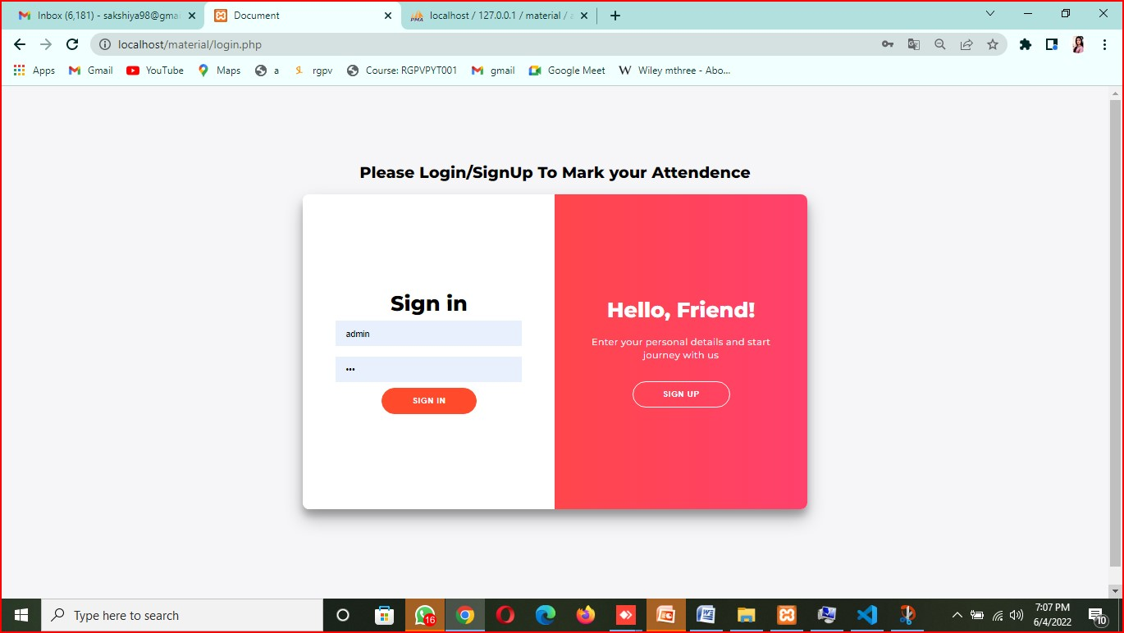
Process of Attendance marking by admin
Firstly admin will login by their user id and password.
2.after login process admin can view that the attendance is marked or not.
3. after the marking process the admin can view student attendance record in the view attendance page.
4.now admin can log out.

Slide 29
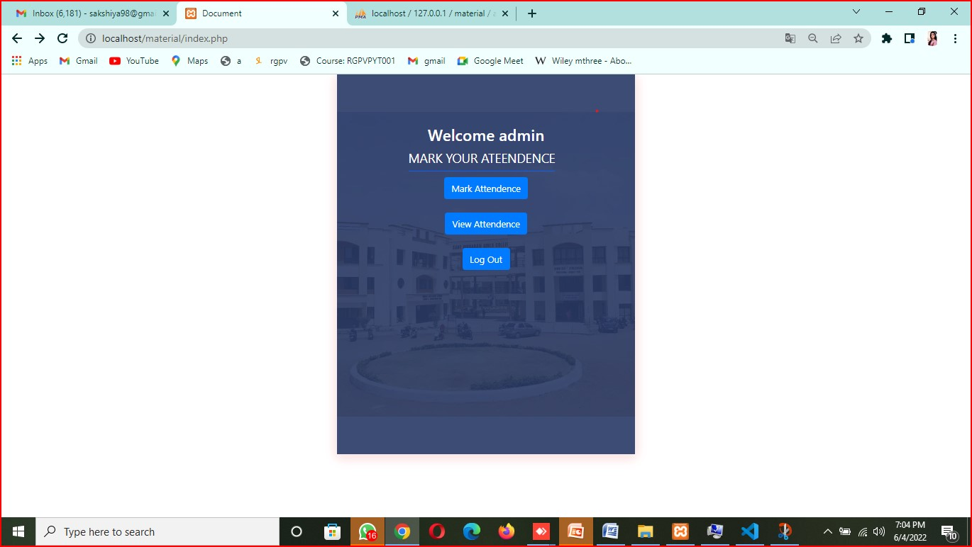
Admin login page

Slide 30
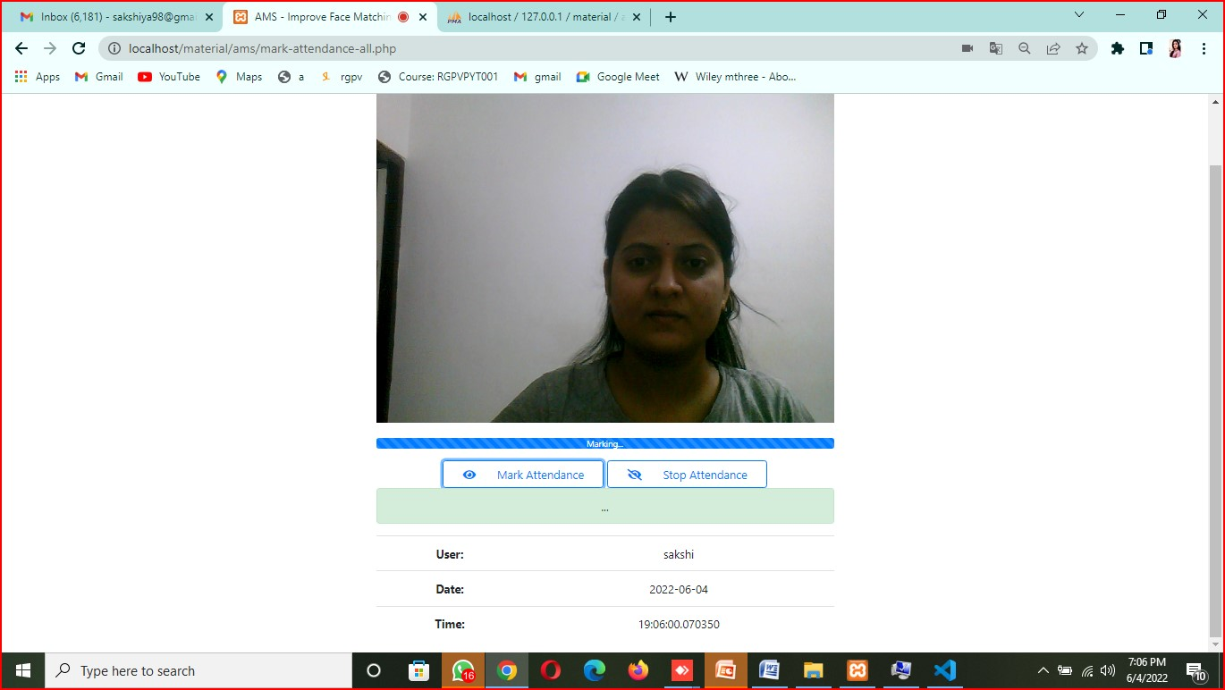
Marking attendance page

Slide 31
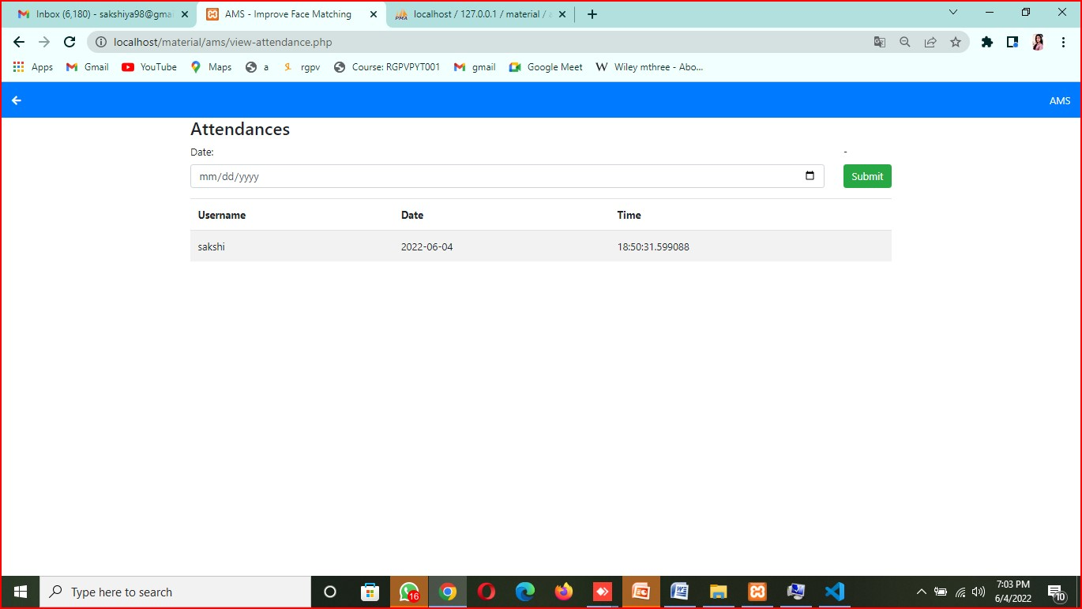
View Attendance page

Slide 32
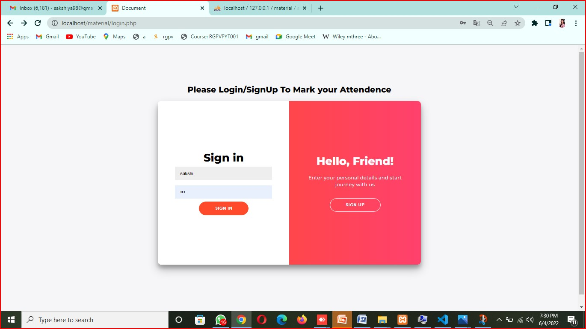
Attendance marking process by user
!. For marking attendance user have to sign up themselves with their user id and password.
2.After sign up process user have to login with their user id and password.

Slide 33
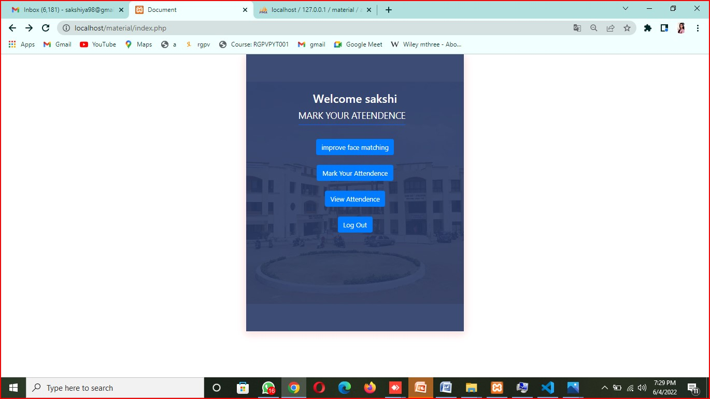
Users login page

Slide 34
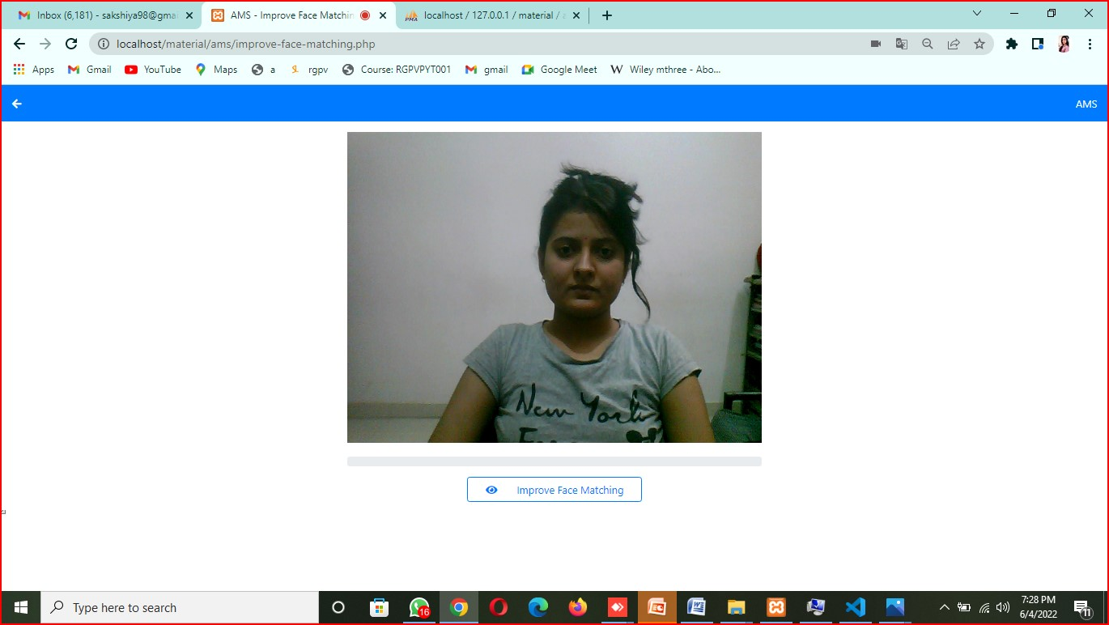
After login process
1.User will click on improve face matching option.
2.In the improve face matching process the HD camera will capture 100 images for particular person,
3.After 100 images it will convert normal images into gray scale images.
4.It will train the given datasets.

Slide 35
5.If the faces of a person in the camera matches with the given data sets by user it will mark attendance otherwise it will through an error by local host.
6. for checking our camera is capturing images or not we have to check our faces folder in that folder the 100 images will be there.
For checking grey scale images we will check Gface folder.

Slide 36
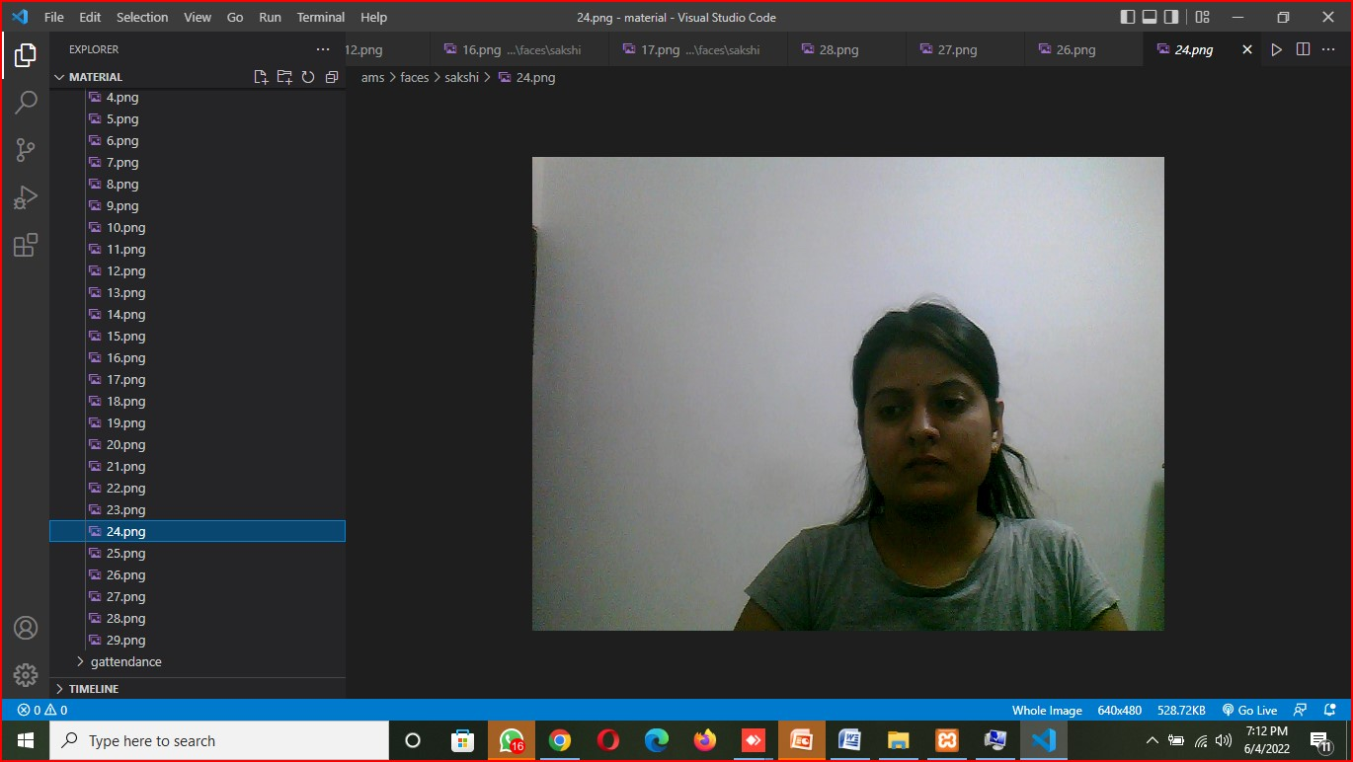
Faces folder

Slide 37
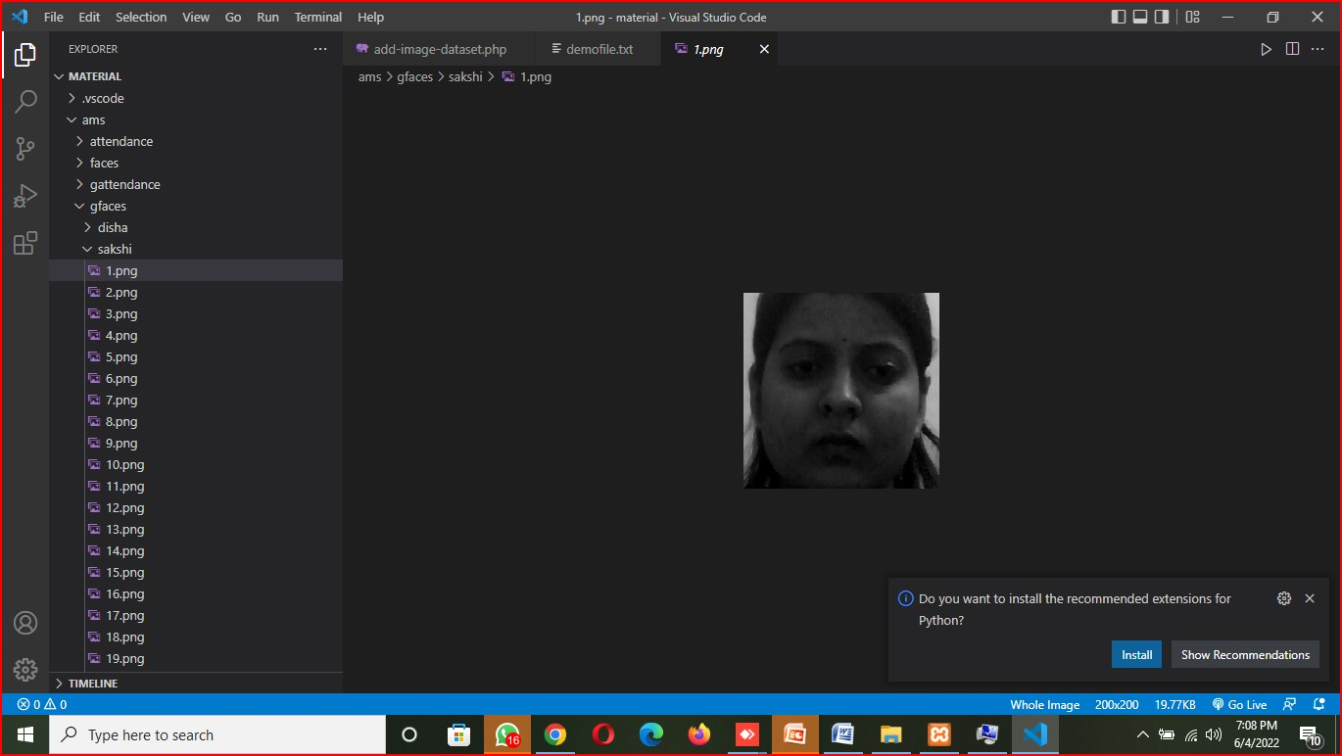
gface

Slide 38
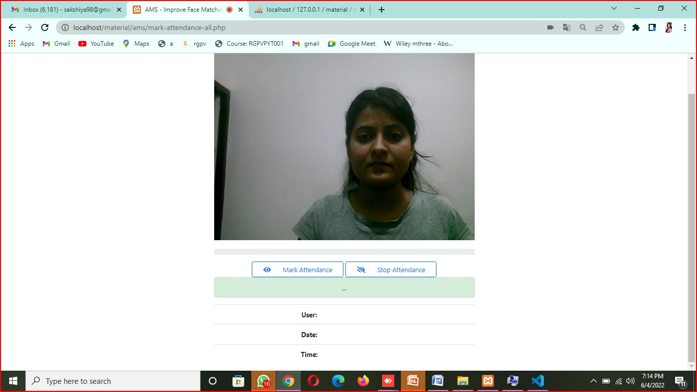
Marking attendance
Marking attendance view
1. Now user can mark their attendance in the marking attendance page.

Slide 39
Attendance marked
Now attendance have been marked with user name and current date and time.

Slide 40
View atendance page

Slide 41
Log out
Now user can log out them selves.

Slide 42
CONCLUSION
This project will help the lecturers to reduce their workload by reducing the time and calculations required to update the attendance manually.
Students and parents will also view the attendance and curriculum details using the website.

